Slide 1

Hockey Recruiting Database
Jeanna Matthews, Mark Santa Clara Munro, Anthony Halliday, Kristiane Rell, Luke Levine, Jonas Petro, William Sacchi
UO-142

Slide 2


The Problem
Recruiting information stored in spreadsheets
Inconsistent formatting, multiple spreadsheets needed, notes generally cluttered
No existing product exists to record the required information
Notes:
Jonas

Slide 3

Our Solution
Web application that fits recruiting needs
Avoids redundancy and clutter
User-friendly
Notes:
Mark

Slide 4

Features
Player information with progress tracking
Player comparison
Player searching and filtering
Offline functionality
Notes:
Mark

Slide 5

How?
Progressive web app designed for Apple Devices
Backend implemented with Django
Front end implemented with Vue
Notes:
William

Slide 6




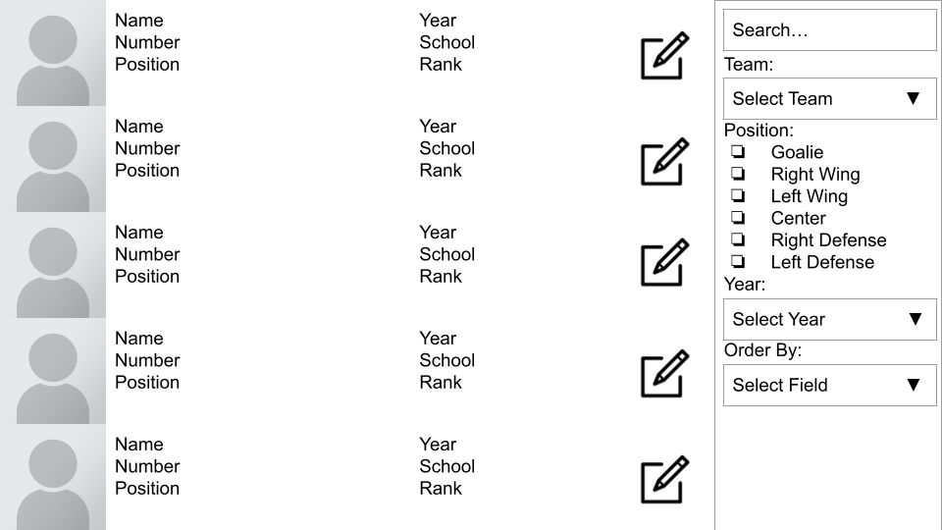




Solution Architecture
Frontend
Backend
Proxied Content
Player Data
API
Service Worker
Static Pages
Runs on Docker
Runs on User’s Browser (Safari)
Notes:
Anthony

Slide 7

The Data
Player names
Contact information
Team information
Notes
Videos
Notes:
William

Slide 8
Backend
REST API implemented in python with django
MySQL database to store player data
Managed using django “models”
Frontend uses API to indirectly query database and get JSON formatted data
API supports full range of CRUD operations (create, read, update, delete)
All backend components located behind NGINX reverse proxy
Serves static pages
Could later provide authentication and authorization through OpenID
Notes:
Luke

Slide 9
API Example - Create Player
POST /api/create/player
{
"first_name":"Samantha",
"last_name":"Sample",
"date_of_birth":"2007-02-06"
}
→ 200 OK
{
"status": "success",
"data": {
"id": 4,
"first_name": "Samantha",
"last_name": "Sample",
"date_of_birth": "2007-02-06",
"position": ""
}
}
Notes:
Luke

Slide 10
API Example - Update Player
POST /api/update/player
{
"id":4,
"date_of_birth":"2007-06-02"
}
→ 200 OK
{
"status": "success",
"data": {
"id": 4,
"first_name": "Samantha",
"last_name": "Sample",
"date_of_birth": "2007-06-02",
"position": ""
}
}
Notes:
Luke

Slide 11
API Example - Read Player or Delete Player
GET /api/get/player?id=4
→ 200 OK
{
"status": "success",
"data": {
"id": 4,
"first_name": "Samantha",
"last_name": "Sample",
"date_of_birth": "2007-02-06",
"position": ""
}
}
DELETE /api/delete/player?id=4
→ 200 OK
{
"status": "success",
"data": {
"id": 4,
"first_name": "Samantha",
"last_name": "Sample",
"date_of_birth": "2007-02-06",
"position": ""
}
}
Notes:
Luke

Slide 12
API Example - Search Player
GET /api/search/player?last_name=Sample
→ 200 OK
{
"status": "success",
"data": [
{
"id": 3,
"first_name": "Sally",
"last_name": "Sample",
"date_of_birth": "2006-03-07",
"position": ""
},
{
"id": 4,
"first_name": "Samantha",
"last_name": "Sample",
"date_of_birth": "2007-02-06",
"position": ""
}
]
}
Notes:
Anthony

Slide 13
API Example - Get a Team
→ 200 OK
{ "status": "success", "data": { "id": 0, "name": "Bruins", "coach_first_name": "John", "coach_last_name": "Smith", "coach_email": "jsmith@gmail.com", "players": [ { "id": 0, "first_name": "Luke", "last_name": "Test", "date_of_birth": "2003-10-10", "position": "Defence", "number_on_team": 10 }, { ... "number_on_team": 12 }, ] } }
GET /api/get/team?id=0
Notes:
Luke

Slide 14

Frontend
Goals
Flexible, streamlined, user-friendly
Frontend framework
Vue.JS
Lightweight, reactive, PWA support
Backend integration
Django REST API
Notes:
Mark
Vue
Fake data for pres

Slide 15
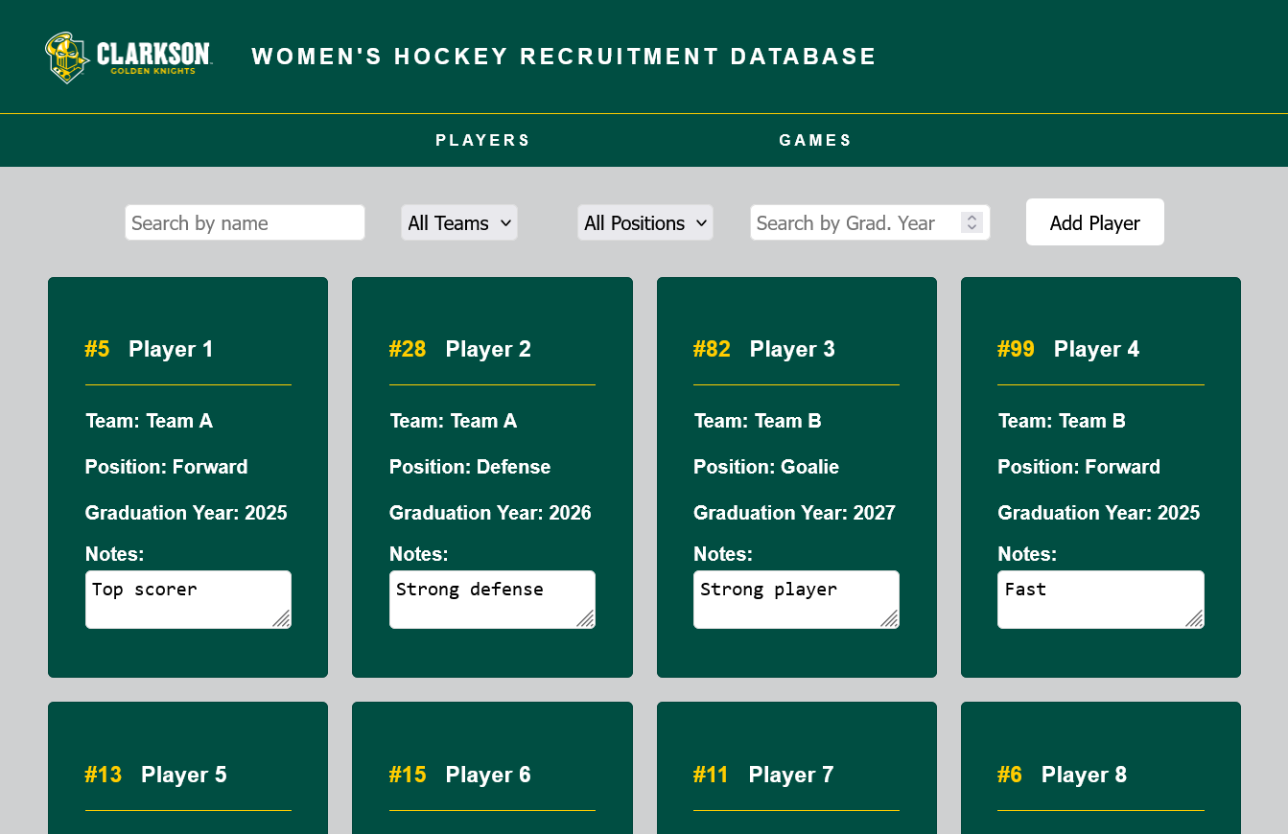
Player Search Page
Searching and filtering by…
Name
Team
Position
Graduation Year
Insightful player info
Simple navigation
Add new players
Notes:
Kristi

Slide 16
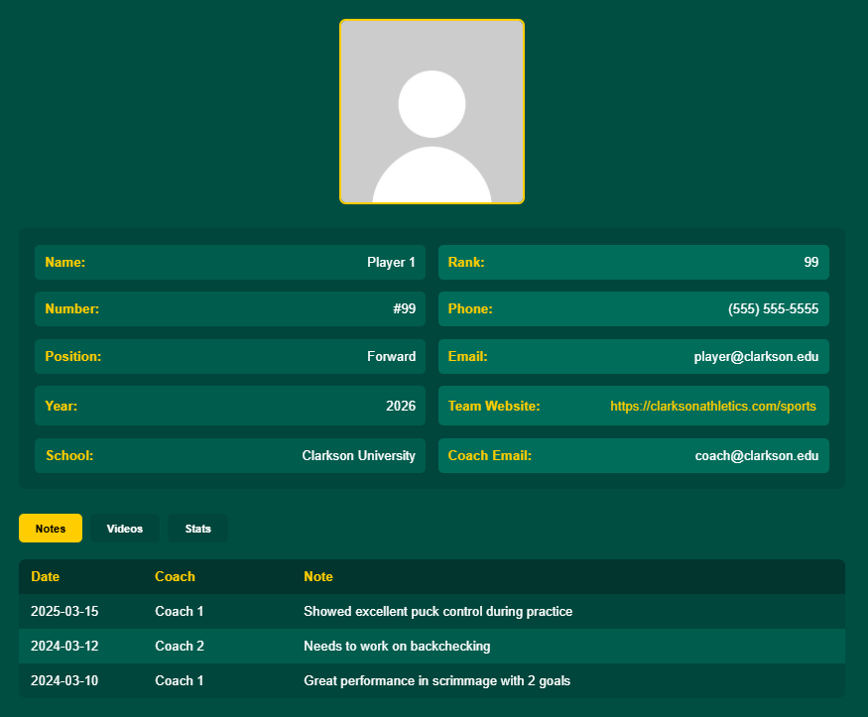
Player Information Page
Personal information
name, rank, position, year, etc.
Team information
coach info, team website
Player tracking
past notes, in-game videos, stats
Notes:
Mark

Slide 17
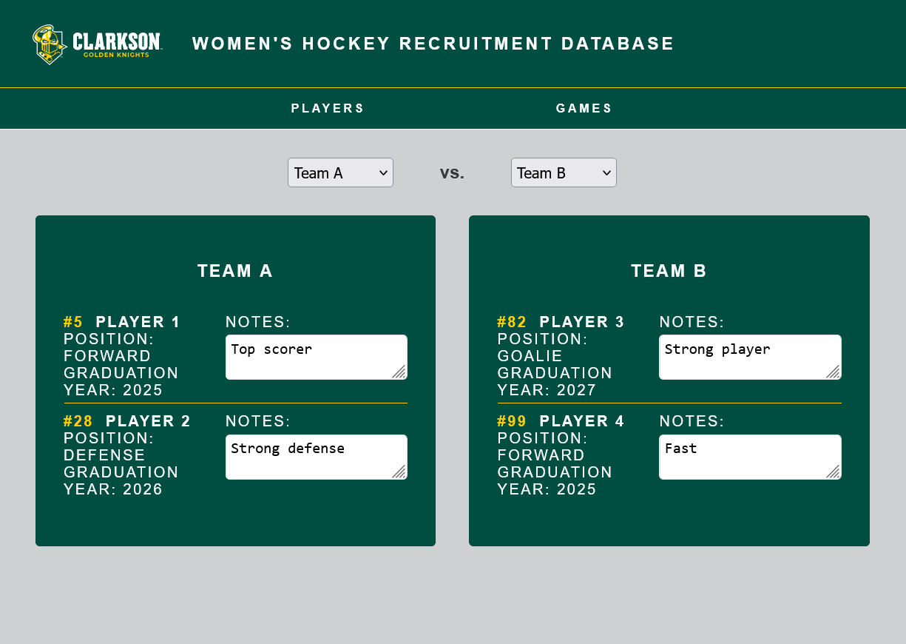
Game Page
Quick comparison of multiple players on two teams
Filter by team
Perfect for adding notes during a game or scrimmage
Notes:
Jonas

Slide 18
Demo

Slide 19
Thank you!

